Slide 1
Factor Analysis
SAS Version

Slide 2
Step 1: Typical Use of the Technique
Factor analysis is usually the first step in the creation of a market segmentation system
A market segmentation system is a system that groups customers, prospects or other individual elements into segments
Each segment is formed so that people who are similar to each other in a number of characteristics reside in the same segment
Each segment also is formed so that it is as different from the other segments as possible in terms of the characteristics
The usual process to produce a market segmentation system is
Factor Analysis of characteristic variables → Cluster Analysis to create segments

Slide 3
Step 1: Typical Use of the Technique
Why is factor analysis useful in this clustering process?
It is useful because it takes variables that are assumed to measure some more abstract latent construct and creates a “factor” or latent variable that represents this latent characteristic
Factor analysis also importantly works to make the factors (latent variables) that it creates orthogonal – that is, uncorrelated with each other
Why might this be useful? Because remember in market segmentation you want to build customer segments that are as different from each other as possible

Slide 4
Step 1: Typical Use of the Technique
What about an example of a latent factor?
Think about these questions in a survey
Have your sleep patterns changed recently?
Has your appetite changed recently?
Are you more irritable lately?
Are you having trouble concentrating?
Have you lost interest in friends and activities of late?
Do you feel tired a lot of the time?
What do these variables when taken together likely indicate in a person?

Slide 5
Step 1: Typical Use of the Technique
What about a business example?
Here is a set of questions – what do you think the latent variable or factor is?
I try to keep up with developments in technology
I love to buy new gadgets and appliances
People often ask my opinion when buying new technology
I’ll pay almost anything for an electronic product that I really want

Slide 6
Step 1: Typical Use of the Technique
What about another business example?
Here is a set of questions – what do you think the latent variable or factor is?
I like to make a fashion statement
Top designers make quality clothes
I am willing to spend more that I can afford to get the clothes I want
I like to experiment with new clothing styles
I really enjoy clothes shopping

Slide 7
Step 1: Typical Use of the Technique
So why don’t we ask these questions in a survey and use some sort of five point scale
Then we could just “add up the numbers” for each question and your depression score is the sum (women’s magazines use this strategy all the time, so it must be correct, right?)
What might be wrong with this approach?

Slide 8
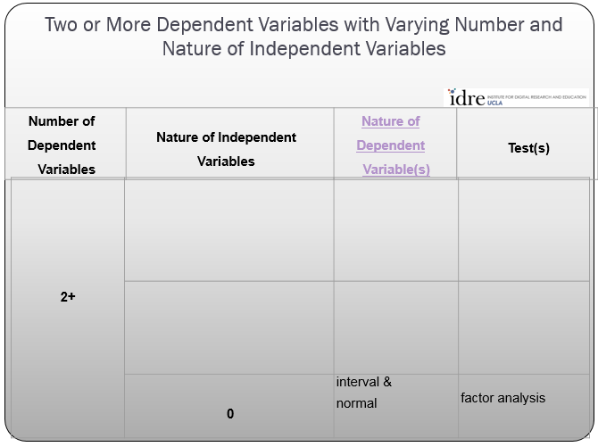
Step 3: Analysis Run
a. Determine the technique to use from idre chart
Notes:
If students will be required to write a research proposal or conduct a study as a course project, or if students have ongoing research projects such as theses or dissertations, and if the class is reasonably small, it may be useful to elicit descriptions of their research interests early in the course and use these research questions as a focus for discussion. If the class is large or students do not have well defined research interests, you may want to focus discussion on the empirical examples presented in the chapter.

Slide 9
Step 1: Typical Use of the Technique
Note here that in factor analysis you might consider the latent variables (factors) the dependent variable here
Also note here for the first time that we are exploring a statistical technique (exploratory factor analysis) whose traditional objective is NOT necessarily to use inferential statistics to provide evidence for some hypothesis (the training wheels are truly coming off!)
Thus except for some minor prerequisite tests, there won’t be much of any talk for this use of factor analysis about “rejecting the null hypothesis” or Type I or Type II errors (heresy!)

Slide 10
Step 1: Typical Use of the Technique
So the one thing you should remember – factor analysis is a data reduction technique
Factor analysis is often used to reduce a series of measures or questions into a single, latent variable and such is a data focused technique. It is has several nice qualities
Measures that are constructed from multiple indicators tend to be better behaved statistically
If one of your measures “drops out” for some reason, you can still limp along with the rest of the measures

Slide 11
Step 1: Typical Use of the Technique
We will be looking to extract two factors from our data
The first latent variable has to do with adoption of technology
The second latent variable has to do with social functions of mobile phone use

Slide 12


Step 1: Typical Use of the Technique
Our Example
Here are the questions from the tech section

Slide 13

Step 1: Typical Use of the Technique
Our Example
questions from the cell phone section

Slide 14
Step 1: Typical Use of the Technique
Empirical Example: Nine items from the Bem Sex Role Inventory
Respondents rate themselves on a five point scale that we will rescale into
1= disagree a lot
to
5 = agree a lot for each question

Slide 15
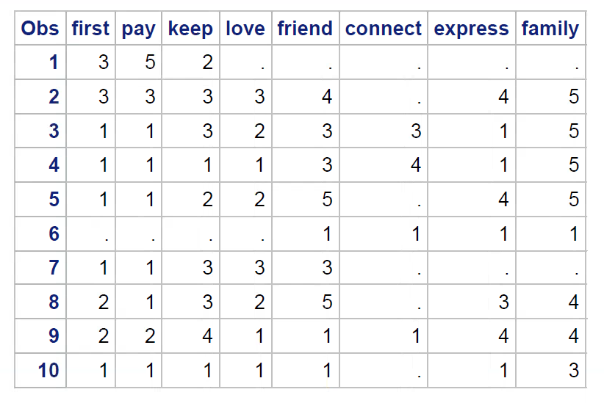
Step 2: Inspect the Data
Our indicators for our two latent variables
Notes:
If students will be required to write a research proposal or conduct a study as a course project, or if students have ongoing research projects such as theses or dissertations, and if the class is reasonably small, it may be useful to elicit descriptions of their research interests early in the course and use these research questions as a focus for discussion. If the class is large or students do not have well defined research interests, you may want to focus discussion on the empirical examples presented in the chapter.

Slide 16
Step 5: Interpretation of the Key Statistics
Extraction Methods
There are different methods for extracting factors from the data. The two most common methods of extraction are principle axis factoring (PAF) and principle components analysis (PCA) and there are big catfights about which one to use.
PCA extraction was traditionally commonly used because it was computationally much easier to perform. PCA focuses on all of the variance each of the variables.
PAF was considered a true factor analysis extraction method and it focuses only on the variance in a variable that is shared with other variables..
Bow tie statisticians prefer the PAF method of extraction because it is a true factor analytic method while wide tie folks prefer PCA extraction
Both extraction methods often but not always produce somewhat similar results.
Note that for factor scores the PCA method has the advantage that the correlation of Factors in the analysis exactly corresponds to the correlation of factor scores that are produced.
Notes:
If students will be required to write a research proposal or conduct a study as a course project, or if students have ongoing research projects such as theses or dissertations, and if the class is reasonably small, it may be useful to elicit descriptions of their research interests early in the course and use these research questions as a focus for discussion. If the class is large or students do not have well defined research interests, you may want to focus discussion on the empirical examples presented in the chapter.

Slide 17
Step 3: Analysis Run
What makes this technique tick?
libname mylib “P:\”;
data myfactor;
set mylib.sasclus;
/* do the factor analysis - set eigenval rotate=varimax scree PCA */
proc factor data = myfactor
maxiter=100
method=principal
mineigen=1
rotate=varimax
msa
scree
score
print;
var first
pay
keep
love
friend
connect
express
family;
run;
Notes:
If students will be required to write a research proposal or conduct a study as a course project, or if students have ongoing research projects such as theses or dissertations, and if the class is reasonably small, it may be useful to elicit descriptions of their research interests early in the course and use these research questions as a focus for discussion. If the class is large or students do not have well defined research interests, you may want to focus discussion on the empirical examples presented in the chapter.

Slide 18
Step 4: Identification of Key Sections
The key tables for PCA are:
Eigenvalue and variance explained table
Scree plot
Kaiser sampling adequacy and partial correlations measure (KMO)
Rotated factor pattern matric
Notes:
If students will be required to write a research proposal or conduct a study as a course project, or if students have ongoing research projects such as theses or dissertations, and if the class is reasonably small, it may be useful to elicit descriptions of their research interests early in the course and use these research questions as a focus for discussion. If the class is large or students do not have well defined research interests, you may want to focus discussion on the empirical examples presented in the chapter.

Slide 19
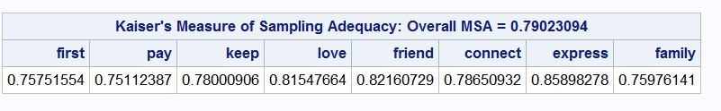
Step 5: Interpretation of the Key Statistics
KMO and Bartlett
Before you can proceed to the factor analysis, you want to make sure that the data you are using is well behaved enough to do the factor analysis
There is a measure that you can use to determine this – the Kaiser Meyer Olkin statistic
The KMO statistic is available in R (KMO {psych}) and in the PFA approach for SAS (msa option) and SPSS (KMO option checkbox)
Notes:
If students will be required to write a research proposal or conduct a study as a course project, or if students have ongoing research projects such as theses or dissertations, and if the class is reasonably small, it may be useful to elicit descriptions of their research interests early in the course and use these research questions as a focus for discussion. If the class is large or students do not have well defined research interests, you may want to focus discussion on the empirical examples presented in the chapter.

Slide 20
Step 5: Interpretation of the Key Statistics
KMO and Barlett
The KMO test estimates the proportion of variance among the variables that might be shared and ranges from 0 to 1.
Kaiser (1974) interprets the ranges as .90s as marvelous, .80s as meritorious, .70s as middling, .60s as mediocre, .50 as miserable and < .5 as unacceptable ( who said statisticians don’t have a sense of humor).
Notes:
If students will be required to write a research proposal or conduct a study as a course project, or if students have ongoing research projects such as theses or dissertations, and if the class is reasonably small, it may be useful to elicit descriptions of their research interests early in the course and use these research questions as a focus for discussion. If the class is large or students do not have well defined research interests, you may want to focus discussion on the empirical examples presented in the chapter.

Slide 21
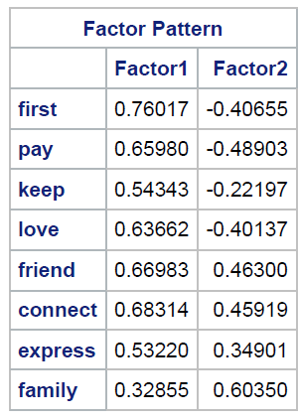
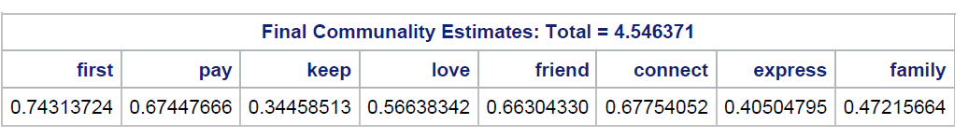
Step 5: Interpretation of the Key Statistics
Communalities
The extraction communality is the percent of variance in the variable that can be reproduced by from the set of extracted factors. You can calculate this by squaring the loadings for the variable in the factor loading matrix and summing the results up (at least in PCA).
First = (.76017)² + (-.40655)² = .7431
Notes:
If students will be required to write a research proposal or conduct a study as a course project, or if students have ongoing research projects such as theses or dissertations, and if the class is reasonably small, it may be useful to elicit descriptions of their research interests early in the course and use these research questions as a focus for discussion. If the class is large or students do not have well defined research interests, you may want to focus discussion on the empirical examples presented in the chapter.

Slide 22
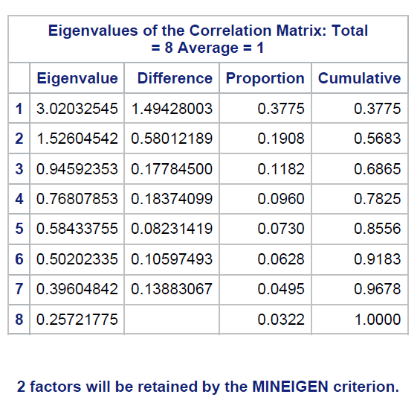
Step 5: Interpretation of the Key Statistics
Factor Extraction Details
Notice that there are eight factors displayed. The procedure will always display the maximum number of calculated factors, which is equal to the number of variables being factor analyzed.
Note we use the Kaiser criterion (eigenvalue => 1) to determine how many factors to keep
proc factor data = myfactor
maxiter=100
method=principal
mineigen=1
rotate=varimax
Notes:
If students will be required to write a research proposal or conduct a study as a course project, or if students have ongoing research projects such as theses or dissertations, and if the class is reasonably small, it may be useful to elicit descriptions of their research interests early in the course and use these research questions as a focus for discussion. If the class is large or students do not have well defined research interests, you may want to focus discussion on the empirical examples presented in the chapter.

Slide 23
Step 5: Interpretation of the Key Statistics
Factor Extraction Details
(PCA Extraction)
Note that each factor has an eigenvalue associated with it. This eigenvalue represents the amount of total variance that can be explained by that factor.
If you total up the eight eigenvalues you will get 8.0, which is the total variance if you assume each variable has a standard variance of 1. To get the % variance explained, just divide the eigenvalue for the factor by the sum of the eigenvalues
So 3.0203 / 8 = .3775 or 37.75% of the variance is explained by factor 1
Notes:
If students will be required to write a research proposal or conduct a study as a course project, or if students have ongoing research projects such as theses or dissertations, and if the class is reasonably small, it may be useful to elicit descriptions of their research interests early in the course and use these research questions as a focus for discussion. If the class is large or students do not have well defined research interests, you may want to focus discussion on the empirical examples presented in the chapter.

Slide 24
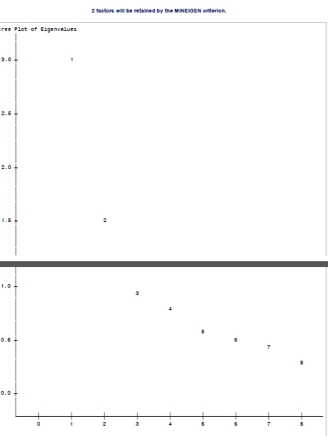
Step 5: Interpretation of the Key Statistics
Factor Extraction Details
There is also a graphical method to estimate how many factors to extract – the scree plot
Mountaineers know that “scree” is the rock crap at the bottom of the steep part of the mountain that falls and rolls down the mountain until it comes to rest.
Where you see the rock stop, pick the number of factors just prior
The Y axis is the
Eigenvalue for
each factor
The axis is the
Factor number
Notes:
If students will be required to write a research proposal or conduct a study as a course project, or if students have ongoing research projects such as theses or dissertations, and if the class is reasonably small, it may be useful to elicit descriptions of their research interests early in the course and use these research questions as a focus for discussion. If the class is large or students do not have well defined research interests, you may want to focus discussion on the empirical examples presented in the chapter.

Slide 25
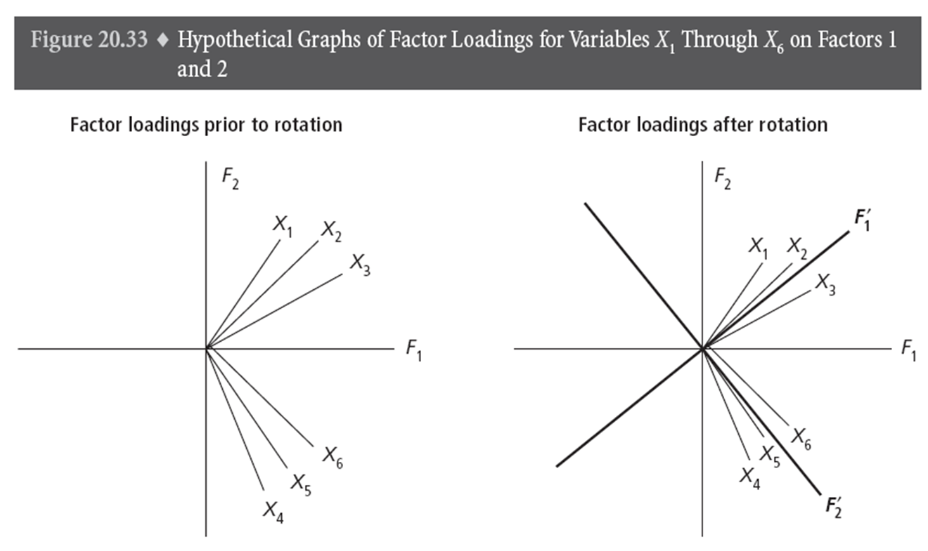
Step 5: Interpretation of the Key Statistics
Rotation – Really?
It turns out that if you rotate the axes that the factors lie on, you can get a much clearer picture and interpretation. You really do need to rotate the factor solution to make any use out of it.
Notes:
If students will be required to write a research proposal or conduct a study as a course project, or if students have ongoing research projects such as theses or dissertations, and if the class is reasonably small, it may be useful to elicit descriptions of their research interests early in the course and use these research questions as a focus for discussion. If the class is large or students do not have well defined research interests, you may want to focus discussion on the empirical examples presented in the chapter.

Slide 26
Step 5: Interpretation of the Key Statistics
Rotation – Really?
Look at variable X₂. If you had to describe it, you would say that it is made up of almost equal parts of F₁ and F₂. Well, that doesn’t sound good – we want our variables to be strongly associated with just one factor – that makes sense. The same with the other X variables.
Notes:
If students will be required to write a research proposal or conduct a study as a course project, or if students have ongoing research projects such as theses or dissertations, and if the class is reasonably small, it may be useful to elicit descriptions of their research interests early in the course and use these research questions as a focus for discussion. If the class is large or students do not have well defined research interests, you may want to focus discussion on the empirical examples presented in the chapter.

Slide 27
Step 5: Interpretation of the Key Statistics
Rotation – Really?
So if we rotate the F₁ and F₂ axes as shown in the right figure, now the X variables all seem to be made up mostly of either factor 1 or factor 2. Hey, that sounds a lot better – we now have our variables in the factor analysis loading pretty much only on one factor.
Notes:
If students will be required to write a research proposal or conduct a study as a course project, or if students have ongoing research projects such as theses or dissertations, and if the class is reasonably small, it may be useful to elicit descriptions of their research interests early in the course and use these research questions as a focus for discussion. If the class is large or students do not have well defined research interests, you may want to focus discussion on the empirical examples presented in the chapter.

Slide 28

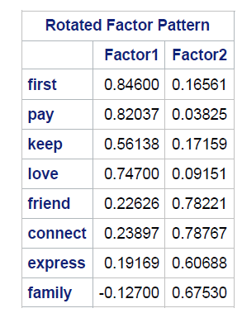
Step 5: Interpretation of the Key Statistics
Rotation – Really?
Compare the differences between the loadings for factor 1 and factor 2 between the two factor matrices. Can you see how rotating the axes helped discriminate variables better between the two factors? Note that rotating the axes did not change any of the actual relationships – it just put a different perspective on the data – it’s really not cheating!
Varimax Rotation
Notes:
If students will be required to write a research proposal or conduct a study as a course project, or if students have ongoing research projects such as theses or dissertations, and if the class is reasonably small, it may be useful to elicit descriptions of their research interests early in the course and use these research questions as a focus for discussion. If the class is large or students do not have well defined research interests, you may want to focus discussion on the empirical examples presented in the chapter.

Slide 29
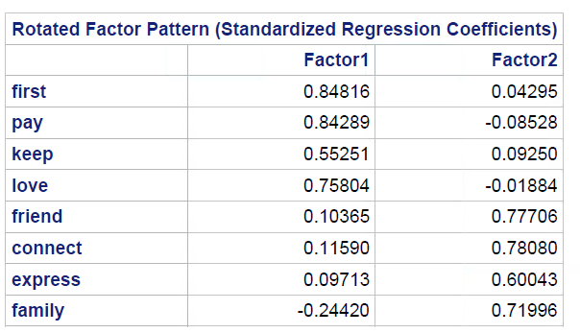
Step 5: Interpretation of the Key Statistics
Rotation – Really?
What if we had decided to do an oblique rotation like PROMAX instead? Here is the factor pattern matrix on the left for PROMAX compared to the VARIMAX rotation on the right. In most of the variables the loadings seem to be somewhat clearer in the PROMAX rotation.
Promax Rotation
Varimax Rotation
Notes:
If students will be required to write a research proposal or conduct a study as a course project, or if students have ongoing research projects such as theses or dissertations, and if the class is reasonably small, it may be useful to elicit descriptions of their research interests early in the course and use these research questions as a focus for discussion. If the class is large or students do not have well defined research interests, you may want to focus discussion on the empirical examples presented in the chapter.

Slide 30
Step 5: Interpretation of the Key Statistics
Rotation – Really?
What if we had decided to do an oblique rotation like PROMAX instead? Here is the factor pattern matrix on the left for PROMAX compared to the VARIMAX rotation on the right. In most of the variables the loadings seem to be somewhat clearer in the PROMAX rotation.
Promax Rotation
Varimax Rotation
Notes:
If students will be required to write a research proposal or conduct a study as a course project, or if students have ongoing research projects such as theses or dissertations, and if the class is reasonably small, it may be useful to elicit descriptions of their research interests early in the course and use these research questions as a focus for discussion. If the class is large or students do not have well defined research interests, you may want to focus discussion on the empirical examples presented in the chapter.

Slide 31
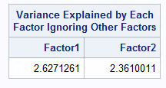
Step 5: Interpretation of the Key Statistics
Rotation – Really?
Here is what happens to the explained variance for the rotated factors using PROMAX.
Promax Rotation
Note that in the PROMAX rotation, if you add the two variance explained numbers up, it comes to more than our original 56%. That’s because the two factors are no longer uncorrelated or independent and so some variance gets “counted twice”.
[(2.6271) + 2.3610) ] / 8 = .6235 or 62.3% of variance explained
Notes:
If students will be required to write a research proposal or conduct a study as a course project, or if students have ongoing research projects such as theses or dissertations, and if the class is reasonably small, it may be useful to elicit descriptions of their research interests early in the course and use these research questions as a focus for discussion. If the class is large or students do not have well defined research interests, you may want to focus discussion on the empirical examples presented in the chapter.

Slide 32
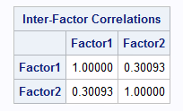
Step 5: Interpretation of the Key Statistics
Rotation – Really?
What if we had decided to do an oblique rotation like PROMAX instead? Here is the factor pattern matrix on the left for PROMAX compared to the VARIMAX rotation on the right. In most of the variables the loadings seem to be somewhat clearer in the PROMAX rotation.
Promax Rotation
Note that here we can see that the two factors are correlated where r=.3
Notes:
If students will be required to write a research proposal or conduct a study as a course project, or if students have ongoing research projects such as theses or dissertations, and if the class is reasonably small, it may be useful to elicit descriptions of their research interests early in the course and use these research questions as a focus for discussion. If the class is large or students do not have well defined research interests, you may want to focus discussion on the empirical examples presented in the chapter.

Slide 33
Step 5: Interpretation of the Key Statistics
Rotation – Really?
And which one do you pick?
Advantage of Varimax = factors are orthogonal and so they are more likely to produce well separated clusters in the cluster analysis.
Disadvantage of Varimax = distorts to some extent reality since it forces the factors to be orthogonal
Advantage of Promax = factors are correlated and more accurately resemble reality
Disadvatange of Promax = factors are oblique so that they are somewhat less likely to produce well separated clusters in the cluster analysis
Notes:
If students will be required to write a research proposal or conduct a study as a course project, or if students have ongoing research projects such as theses or dissertations, and if the class is reasonably small, it may be useful to elicit descriptions of their research interests early in the course and use these research questions as a focus for discussion. If the class is large or students do not have well defined research interests, you may want to focus discussion on the empirical examples presented in the chapter.

Slide 34
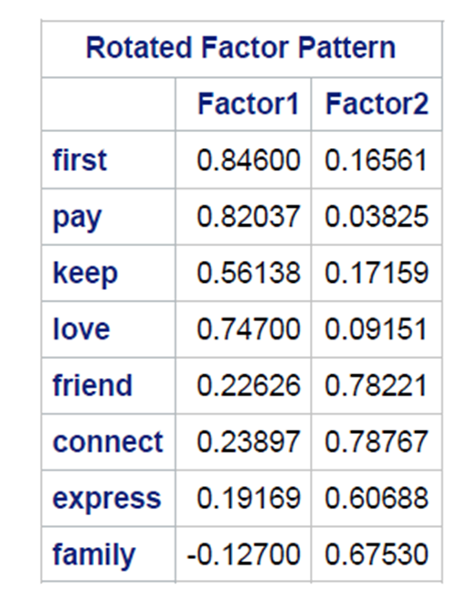
Step 5: Interpretation of the Key Statistics
Now it’s Miller time!
That is, we get to interpret the factor analysis
Looking at the rotated factor matrix look at each row that represents a variable. Find the factor with the highest loading for that variable.
For example, for first, Factor1 has the highest absolute value loading of .846 (compared to .165).
Do that for each of the eight rows.
Often analysts get their printout and whip out their highlighting pens and go wild highlighting the highest loading in each row.
Notes:
If students will be required to write a research proposal or conduct a study as a course project, or if students have ongoing research projects such as theses or dissertations, and if the class is reasonably small, it may be useful to elicit descriptions of their research interests early in the course and use these research questions as a focus for discussion. If the class is large or students do not have well defined research interests, you may want to focus discussion on the empirical examples presented in the chapter.

Slide 35
Step 5: Interpretation of the Key Statistics
Now it’s Miller time!
That is, we get to interpret the factor analysis
How do you decide which factor goes with which variable?
The higher the absolute value of the number, the stronger the association between the variable and the factor.
Negative numbers mean that there is a negative rather than positive relationship between the variable and the factor.
Higher loadings are generally happy events. There is no hard and fast rule about what is a good loading. Generally anything under .4 is not so fabulous, .5 is middling, .6 is decent, .7 good and .8 and above fabulous.
Obviously a loading in the .9 or above range suggests that the variable is almost as good at the factor, so why bother doing the factor analysis – or something may be wrong somewhere.
Notes:
If students will be required to write a research proposal or conduct a study as a course project, or if students have ongoing research projects such as theses or dissertations, and if the class is reasonably small, it may be useful to elicit descriptions of their research interests early in the course and use these research questions as a focus for discussion. If the class is large or students do not have well defined research interests, you may want to focus discussion on the empirical examples presented in the chapter.

Slide 36
Step 5: Interpretation of the Key Statistics
Now it’s Miller time!
That is, we get to interpret the factor analysis
How do you interpret this matrix?
Well, you look at each factor and note which variables it loads high on. Remember that the factor is a latent variable that is supposed to represent an unobservable common construct among the variables.
So remember we felt that one of the factors would represent early adopter of technology – that appears to be Factor 1
Our other factor was social media use and so it looks like Factor2 represents this
Notes:
If students will be required to write a research proposal or conduct a study as a course project, or if students have ongoing research projects such as theses or dissertations, and if the class is reasonably small, it may be useful to elicit descriptions of their research interests early in the course and use these research questions as a focus for discussion. If the class is large or students do not have well defined research interests, you may want to focus discussion on the empirical examples presented in the chapter.

Slide 37

Step 5: There’s a bit more decision making to do…
Catfight #2 - Back to rotation for a few more points…
I kind of glossed over rotation because I wanted to communicate the basic idea of how rotation can help in interpretation.
But did you know that there is more than one kind of rotation?
Yep, there are two basic classes of rotations – orthogonal and oblique. The rotation we did below was an orthogonal rotation. That is, in an orthogonal rotation the factors are made as close to uncorrelated as possible (orthogonal refers to the 90 degree angle in the factor axes below.
Notes:
If students will be required to write a research proposal or conduct a study as a course project, or if students have ongoing research projects such as theses or dissertations, and if the class is reasonably small, it may be useful to elicit descriptions of their research interests early in the course and use these research questions as a focus for discussion. If the class is large or students do not have well defined research interests, you may want to focus discussion on the empirical examples presented in the chapter.

Slide 38
Step 5: There’s a bit more decision making to do…
Back to rotation for a few more points…
Why is orthogonal rotation a good thing? Remember back to the beginning of this deck, we talked about how factor analysis was the first stage of a market segmentation.
The second stage of the market segmentation was the application of a clustering technique and that the objective of that technique was to make the segments as unique from each other as possible. In order to do that, we want the variables that drive the clustering or grouping of individuals to be – you guessed it – orthogonal or non-correlated with each other.
Orthogonal rotation also is handy in dealing with constructing factor scores (in a few minutes)
Notes:
If students will be required to write a research proposal or conduct a study as a course project, or if students have ongoing research projects such as theses or dissertations, and if the class is reasonably small, it may be useful to elicit descriptions of their research interests early in the course and use these research questions as a focus for discussion. If the class is large or students do not have well defined research interests, you may want to focus discussion on the empirical examples presented in the chapter.

Slide 39
Step 5: There’s a bit more decision making to do…
Back to rotation for a few more points…
And there is more than one kind of orthogonal rotation. There are typically varimax, quartimax and equimax orthogonal rotations. Each type pursues a slightly different strategy. Normally folks settle for varimax.
Notes:
If students will be required to write a research proposal or conduct a study as a course project, or if students have ongoing research projects such as theses or dissertations, and if the class is reasonably small, it may be useful to elicit descriptions of their research interests early in the course and use these research questions as a focus for discussion. If the class is large or students do not have well defined research interests, you may want to focus discussion on the empirical examples presented in the chapter.

Slide 40
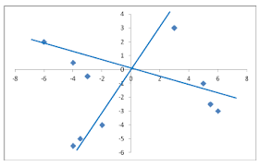
Step 5: There’s a bit more decision making to do…
Back to rotation for a few more points…
And there is more than one kind of oblique rotation. There are typically direct oblimin and promax oblique rotations. Each type pursues a slightly different strategy. Normally folks settle for promax.
Notes:
If students will be required to write a research proposal or conduct a study as a course project, or if students have ongoing research projects such as theses or dissertations, and if the class is reasonably small, it may be useful to elicit descriptions of their research interests early in the course and use these research questions as a focus for discussion. If the class is large or students do not have well defined research interests, you may want to focus discussion on the empirical examples presented in the chapter.

Slide 41
Step 6: Reinforcement of Most Crucial Key Statistics
Use the Kaiser Meyer Olkin test to check to see that there is enough correlation among the variables you are going to factor analyze
Notes:
If students will be required to write a research proposal or conduct a study as a course project, or if students have ongoing research projects such as theses or dissertations, and if the class is reasonably small, it may be useful to elicit descriptions of their research interests early in the course and use these research questions as a focus for discussion. If the class is large or students do not have well defined research interests, you may want to focus discussion on the empirical examples presented in the chapter.

Slide 42
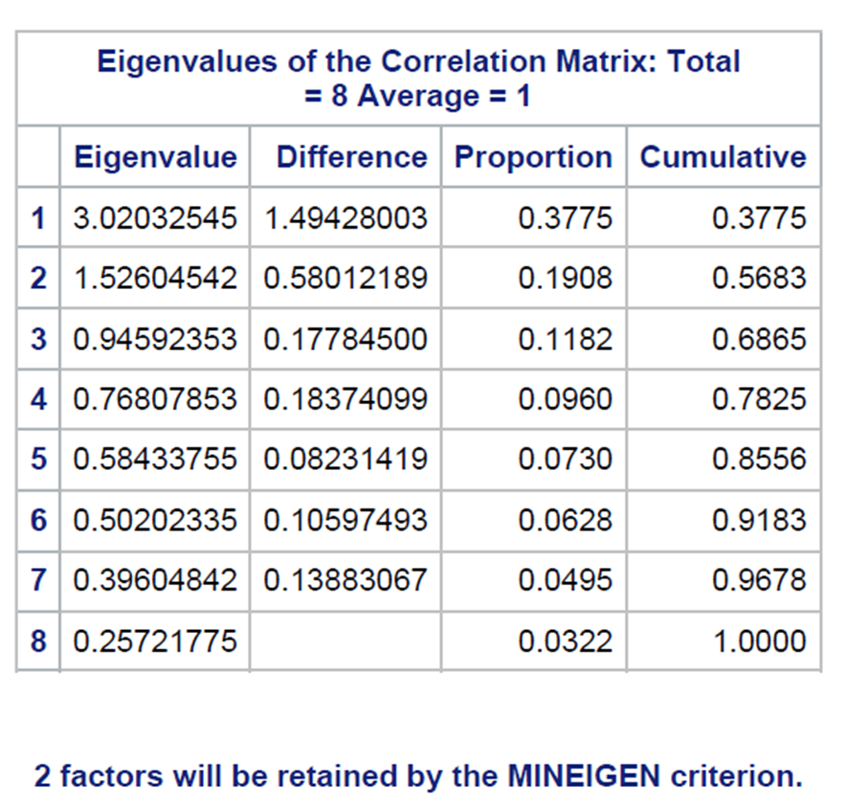
Step 6: Reinforcement of Most Crucial Key Statistics
See how many factors were extracted.
Examine the total variance explained by the factors – if it is low then the variables you have selected likely are not highly correlated with each other.
Notes:
If students will be required to write a research proposal or conduct a study as a course project, or if students have ongoing research projects such as theses or dissertations, and if the class is reasonably small, it may be useful to elicit descriptions of their research interests early in the course and use these research questions as a focus for discussion. If the class is large or students do not have well defined research interests, you may want to focus discussion on the empirical examples presented in the chapter.

Slide 43
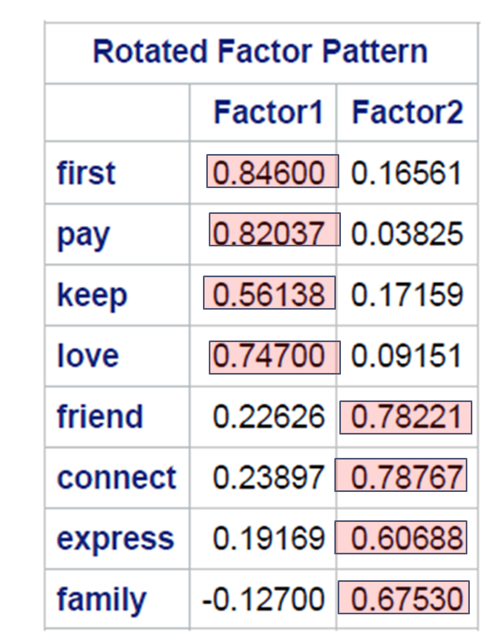
Step 6: Reinforcement of Most Crucial Key Statistics
Interpret your rotated factor matrix.
Notes:
If students will be required to write a research proposal or conduct a study as a course project, or if students have ongoing research projects such as theses or dissertations, and if the class is reasonably small, it may be useful to elicit descriptions of their research interests early in the course and use these research questions as a focus for discussion. If the class is large or students do not have well defined research interests, you may want to focus discussion on the empirical examples presented in the chapter.

Slide 44
Step 7: Sample Size and Power
Things that will make for a better factor analysis
Decent correlations among the variables being used in the factor analysis
Be sure that you don’t omit important variables that are key to the idea of the latent variable you are constructing
Sample size – Comrey and Lee (1992) suggest that 50 cases is very poor, 100 is poor, 200 is fair, 300 is good, 500 is very good and 1,000 cases is excellent.
Bare minimum of 10 cases per variable in the factor analysis

Slide 45
Step 8: Assumptions of the Test
Variables are quantitative in nature and reasonably normally distributed.
Relationships among variables should be linear in nature
Absence of outliers in the data that may skew correlations among the variables.
There should be reasonably strong correlations among the variables.
At least three variables should constitute a factor

Slide 46
Step 9: Notes
There are two basic kinds of factor analysis – exploratory and confirmatory
Exploratory factor analysis assumes that the researcher does not wish to test a hypothesis that a specific number of factors or types of factors are present in the data
Confirmatory factor analysis is used by researchers to test the idea about the number or nature of factors present in the data.
Factor analysis turns out to be useful not only in market segmentation but also in things like scoring respondents on specific scales. More about this in the segue on factor scores.

